Slide 1
CHANGALI RADHAKRISHNA GOUD
Final Project
3/21/2024 Annual Review

Slide 2
PROJECT TITLE
KEYLOGGERS & security
3/21/2024 Annual Review

Slide 3


AGENDA
* Introduction of keyloggers and security
*Understanding the problem statement
*Overview of the project
*Identifying the end users
*Introducing yours solution
*Highlighting the uniquevalue propostions
*Modelling
*Result
3/21/2024 Annual Review

Slide 4

PROBLEM STATEMENT
*Keyloggers are software or hardware tools designed to capture and record keystrokes made on a keyboard
*Brief Description of the Project's Scope and Objectives
*Overview of Keylogger Detection and Prevention Strategies
*Importance of Developing Effective Solutions in the Cybersecurity Landscape
3/21/2024 Annual Review

Slide 5

PROJECT OVERVIEW
Keylogger can be implemented in different ways. They may be software-based, where a program is installed on a computer to capture keystrokes, or hardware-based, involving physical devices connected between the keyboard and the computer. Some advanced keylogger can also capture screenshots, log mouse clicks, and monitor other activities.
It's important to note that the use of keylogger without the consent of the individual being monitored is generally considered unethical and, in many cases, illegal. Privacy laws and regulations vary by jurisdiction, and individuals have the right to know and consent to being monitored.
3/21/2024 Annual Review

Slide 6

WHO ARE THE END USERS?
*Identification of Potential End Users: Individuals, Businesses, Organizations
*Understanding Their Needs and Concerns Regarding
*Keylogger Protection
*Tailoring Solutions to Meet the Requirements of Various User Groups
3/21/2024 Annual Review

Slide 7

YOUR SOLUTION AND ITS VALUE PROPOSITION
*Anti-Key-logger – As the name suggest these are the software which are anti / against key loggers and main task is to detect key-logger from a computer system.
*Anti-Virus – Many anti-virus software also detect key loggers and delete them from the computer system. These are software anti-software so these can not get rid from the hardware key-loggers.
*Automatic form filler – This technique can be used by the user to not fill forms on regular bases instead use automatic form filler which will give a shield against key-loggers as keys will not be pressed .
*One-Time-Passwords – Using OTP’s as password may be safe as every time we login we have to use a new password.
Patterns or mouse-recognition – On android devices used pattern as a password of applications and on PC use mouse recognition, mouse program uses mouse gestures instead of stylus.
3/21/2024 Annual Review

Slide 8


THE WOW IN YOUR SOLUTION
*Revolutionary AI-Powered Detection: Our solution utilizes cutting-edge artificial intelligence (AI) algorithms to detect and prevent keylogger threats with unprecedented accuracy and efficiency. By continuously analyzing user behavior patterns and keystroke dynamics, our AI-driven system can identify even the most sophisticated keyloggers in real-time, providing proactive protection against evolving threats.
*Predictive Behavioral Analysis and Auto-Remediation: Our solution harnesses the power of predictive behavioral analysis to anticipate and preemptively neutralize keylogger threats. By analyzing user behavior patterns and device interactions in real-time, our system can accurately predict when a keylogger is attempting to compromise the system.
3/21/2024 Annual Review
8

Slide 9
MODELLING
Teams cam add wireframes
*Behavioral Modeling:
Action Sequences: Logging sequences of user actions to detect anomalies.
*Heuristic Analysis: Using rules to identify suspicious behavior.
Statistical Modeling:
*Anomaly Detection: Identifying deviations from normal behavior.
*Machine Learning: Training models to detect keylogger patterns.
*Pattern Recognition: Identifying known keylogger signatures.
Database Comparison: Checking against databases of known threats.
3/21/2024 Annual Review
9

Slide 10
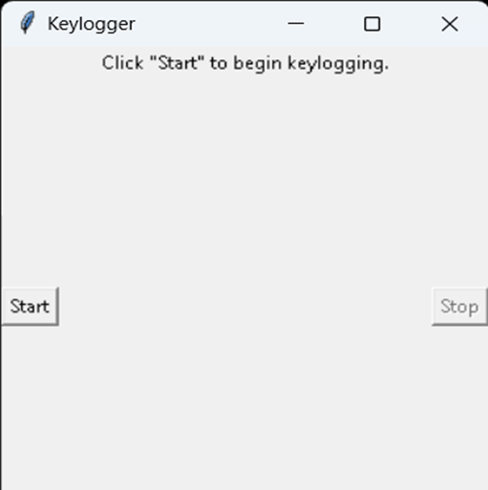
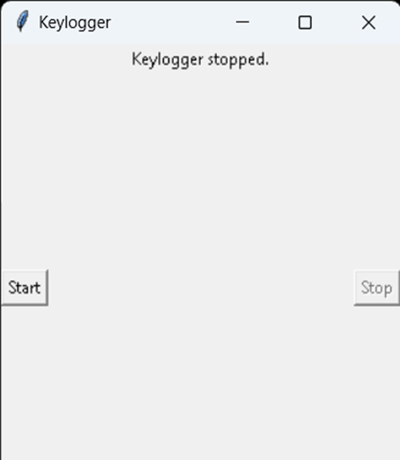

Slide 11
RESULTS
This out put of key_json
[{"Pressed": "'h'"}, {"Held": "'h'"}, {"Released": "'h'"}, {"Pressed": "'e'"}, {"Held": "'e'"}, {"Released": "'e'"}, {"Pressed": "'l'"}, {"Held": "'l'"}, {"Released": "'l'"}, {"Pressed": "'l'"}, {"Held": "'l'"}, {"Released": "'l'"}, {"Pressed": "'o'"}, {"Held": "'o'"}, {"Released": "'o'"}, {"Pressed": "Key.space"}, {"Held": "Key.space"}, {"Released": "Key.space"}, {"Pressed": "'e'"}, {"Held": "'e'"}, {"Released": "'e'"}, {"Pressed": "'v'"}, {"Held": "'v'"}, {"Released": "'v'"}, {"Pressed": "'e'"}, {"Held": "'e'"}, {"Released": "'e'"}, {"Pressed": "'r'"}, {"Held": "'r'"}, {"Released": "'r'"}, {"Pressed": "'y'"}, {"Held": "'y'"}, {"Released": "'y'"}, {"Pressed": "'o'"}, {"Held": "'o'"}, {"Released": "'o'"}, {"Pressed": "'n'"}, {"Held": "'n'"}, {"Released": "'n'"}, {"Pressed": "'e'"}, {"Held": "'e'"}, {"Released": "'e'"}, {"Pressed": "Key.space"}, {"Held": "Key.space"}, {"Released": "Key.space"}, {"Pressed": "'t'"}, {"Held": "'t'"}, {"Released": "'t'"}, {"Pressed": "'i'"}, {"Held": "'i'"}, {"Released": "'i'"}, {"Pressed": "'h'"}, {"Held": "'h'"}, {"Released": "'h'"}, {"Pressed": "Key.backspace"}, {"Held": "Key.backspace"}, {"Released": "Key.backspace"}, {"Pressed":
This out put of key-log text
'h''e''l''l''o'Key.space't''h''i''s'Key.space'k''r''i''s''j'Key.backspace'h'Key.spaceKey.backspaceKey.backspaceKey.backspaceKey.backspaceKey.backspaceKey.backspaceKey.backspaceKey.backspaceKey.backspaceKey.backspaceKey.backspace'e''v''e''r''y''o''n''e'Key.space't''h''i''s'Key.space'k''r''i''s''h'
3/21/2024 Annual Review
11

